Slide 1

Note: The data and information in this document is reflective of a hypothetical situation and client. This document is to be used for KPMG Virtual Internship purposes only.
Sprocket Central Pty Ltd
Data analytics approach
Aayush Jangid

Slide 2
Note: The data and information in this document is reflective of a hypothetical situation and client. This document is to be used for KPMG Virtual Internship purposes only.
Agenda
Introduction
Data Exploration
Model Development
Interpretation

Slide 3
Note: The data and information in this document is reflective of a hypothetical situation and client. This document is to be used for KPMG Virtual Internship purposes only.
Introduction
Identify and Recommend Top 1000 Customer to Target from Datasets
Outline of Problem
Contents of Data Analysis
Sprocket Central is a company that specializes in high-quality bike and accessories.
The Marketing team is looking to boost sales
To target 1000 new customer that will bring the highest value to the business
Bike Related Purchases for the last 3 years based on Gender.
Top Industries contributing the maximum profit and bike related sales
Wealth Segment by Age Category
Number of Cars owned in each state
Customer Classification

Slide 4
Note: The data and information in this document is reflective of a hypothetical situation and client. This document is to be used for KPMG Virtual Internship purposes only.
Data Exploration
Bike related purchases over the last 3 Years based on Gender.
Data Shows, on average females have made bike related purchases in the last 3 years compared to males.
On Average Females have had around 2% higher bike related purchases compared to men in the last 3 years.

Slide 5
Note: The data and information in this document is reflective of a hypothetical situation and client. This document is to be used for KPMG Virtual Internship purposes only.
Data Exploration
Top job industry contributing to maxing profit & bike related purchases
The top 3 industry sectors bringing in the highest profit are: Financial Services, Manufacturing, and Health
These can be obvious as most of these industry sectors are based within the city or on the outskirts of the city therefore customers prefer for commuting.
Most of the Industry sectors have returned less than $1000000 in profits.

Slide 6
Note: The data and information in this document is reflective of a hypothetical situation and client. This document is to be used for KPMG Virtual Internship purposes only.
Data Exploration
Profit of Wealth Segment by Age Group
Overall, the Mass customer segmentation makes the highest profit across the different age groups.
Mass Customer who are adult are likely to bring more profit for the company to other age clusters.
This also indicates a trend of buying power, as the buying power increases over time in adult age then declines, thus leading to lower profits.

Slide 7
Note: The data and information in this document is reflective of a hypothetical situation and client. This document is to be used for KPMG Virtual Internship purposes only.
Data Exploration
Number of cars owned in each State
NSW, QLD & VIC could be potential market opportunities for the company
NSW has the highest potential as the number of people that own car is almost equal to the number of people who don’t own cars which shows that there is an opportunity to find value customers there.

Slide 8
Note: The data and information in this document is reflective of a hypothetical situation and client. This document is to be used for KPMG Virtual Internship purposes only.
Model Development
Customer Classification – Targeting High Value Customers
There are the high value customers that should be targeted from the new list:
Most of the high value customers will be female compared to male.
Working in the financial services, manufacturing & health industry sector.
Adult age group.
Who are currently living in NSW, VIC.

Slide 9
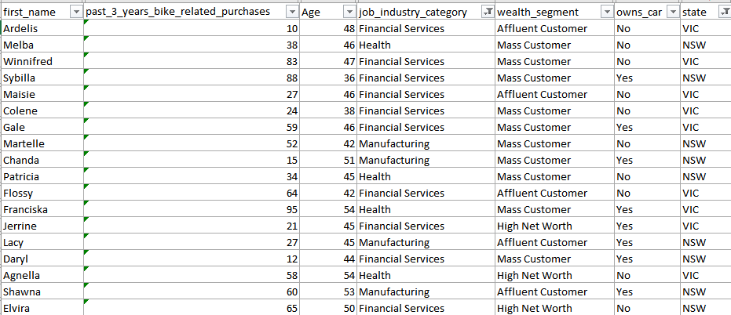
Note: The data and information in this document is reflective of a hypothetical situation and client. This document is to be used for KPMG Virtual Internship purposes only.
Interpretation
Summary Table for High Value Customers
Here is a snapshot of a few customers that will come under the high value customer classification

Slide 10
Note: The data and information in this document is reflective of a hypothetical situation and client. This document is to be used for KPMG Virtual Internship purposes only.
Thank You

